Slide 1
HV Tower Monitoring
Failure detection with CNN

Slide 2

Agenda
1
Methodology
2
Business Understanding
3
Data Understanding
4
Data Preparation
5
Deployment
6
Evaluation
7
Deployment

Slide 3
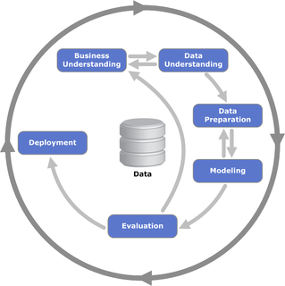
1. Methodology
CRISP-DM has become a de facto standard process model for data mining and is widely used across various industries for data-driven projects. The methodology is designed to be generic and adaptable, making it suitable for a wide range of data mining projects, including but not limited to customer segmentation, fraud detection, risk management, and predictive maintenance.

Slide 4
2. Business Understanding
This initial phase focuses on understanding the project objectives and requirements from a business perspective, then converting this knowledge into a data mining problem definition, and finally into a preliminary plan designed to achieve the objectives.
Objective: Develop a model to detect and classify failures on high voltage towers using images, aiming to improve maintenance efficiency and reduce potential hazards.
Secondary objective: Create a report of the total health index of a tower
Requirements: The model needs to be accurate in identifying four types of failures: paint, rust, deformation, and foreign objects.

Slide 5
3. Data Understanding
This phase starts with an initial data collection and proceeds with activities to get familiar with the data, to identify data quality problems, or to discover first insights into the data.
Data Collection: Gather images of high voltage towers with annotations (bounding boxes and labels).
Data Exploration: Assess the number, quality, and representativeness of the images. Identify any issues with the annotations.
Quality Problems: Note any missing labels, unclear images, or incorrectly marked bounding boxes.

Slide 6
4. Data preparation
The data preparation phase covers all activities to construct the final dataset from the initial raw data. This may include table, record, and attribute selection, as well as transformation and cleaning of data.
Pre-processing: Normalize image sizes, enhance image quality if necessary, and split the data into training, validation, and testing sets.
Labeling: Ensure each image is correctly labeled with the corresponding failure type and that bounding boxes accurately reflect the areas of failure.
Augmentation: Consider augmenting your dataset to include more varied conditions (e.g., different lighting, angles).

Slide 7
5. Modeling
In this phase, various modeling techniques are selected and applied, and their parameters are calibrated to optimal values.
Algorithm Selection: Choose appropriate object detection algorithms (e.g., Faster R-CNN, YOLO, SSD).
Training: Train models using your prepared dataset, ensuring that you use cross-validation or a similar technique to avoid overfitting.
Tuning: Adjust parameters and algorithms based on the performance on the validation set.

Slide 8
6. Evaluation
After modeling, you need to thoroughly evaluate the model and review the steps executed to construct the model to be certain it properly achieves the business objectives.
Performance Metrics: Use metrics like precision, recall, F1 score, and accuracy specifically for object detection tasks.
Review: Assess if the business objectives are met and if there are any factors that could affect the model's deployment and performance.

Slide 9
7. Deployment
The deployment phase involves the implementation of the model into a real business environment to start getting insights and making actionable decisions based on its predictions.
Integration: Integrate the model into the maintenance workflow for high voltage towers.
Monitoring and Maintenance: Regularly evaluate the model's performance and update it with new data.
Feedback Loop: Establish a mechanism for feedback from the maintenance team to continuously improve the model.

Slide 10

?

Slide 11
8. Open Questions: environment
How to set up a VSC environment with the needed storage capacity?
It runs locally with GPU @Steven, so do we need VSC?
Alternative is Google drive with GoogleColab

Slide 12
8. Open Questions: Dataset
How much samples do we need? Now there are 428 samples of failures on 1207 images (→ 20 GB)
Do we need to resize the images (now 5280 x 3956)? Or can we use HRNet, or High-Resolution Net (https://pprp.github.io/timm/models/hrnet/)
Each image has 1 bounding box with 1 failure What if an image has more than 1 failure? Those failures will be across multiple images. Can this be a problem for learning?
Bbox coordinates are not correct nor consistent

Slide 13
8. Open Questions: Coding
Pytorch dataset: What is the area used for?
How to split the data in Training and Test set? → torch.utils.data.random_split
Function evaluate() → cpu_device = torch.device("cpu") Why?
Impact batch_size, now = 2
I cannot execute more than 0 num_workers
How to interpret the results?
How to refine the model?

Slide 14
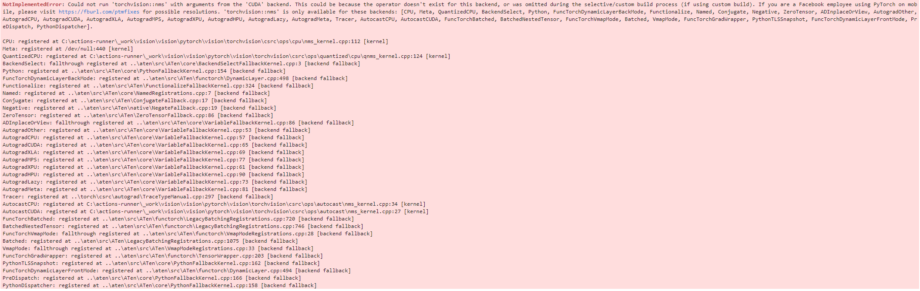
9. Errors
Tempory solution → ImageFile.LOAD_TRUNCATED_IMAGES = True
Solution→ Restart kernel

